Slide 1
Weakly supervised object localization
Thesis midterm – 15/2/2023
Geert Goemaere

Slide 2
Content
Introduction
Research question
Method
Experiments
Next steps

Slide 3
Introduction

Slide 4
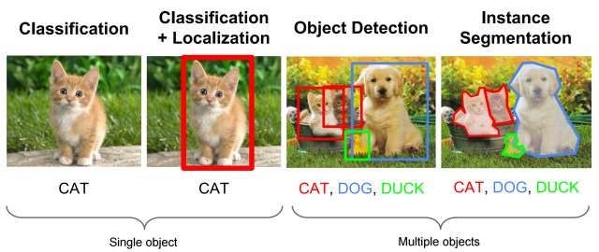
Context: Object recognition tasks
WSOL
Multiple-instance WSOL
Notes:
The research topic of this thesis is called “multiple-instance weakly supervised object localization” (multiple-instance WSOL).
Let’s look at the picture to explain the topic in the field of object recognition tasks. From left to right we have:
Image classification deals with assigning a single label or category) to an image. Here the label is CAT.
Object localization deals with localizing objects in an image by indicating their bounding box. In the case of WSOL, only a single object is localized.
Object detection is the task of locating objects in an image with bounding boxes and assigning a class label for each detection.
Instance segmentation deals with assigning a class label for each pixel of an image.
In this project I will
assess the performance of specific WSOL methods for images with multiple object instances
Investigate mechanisms for those WSOL methods to improve localization of multiple object instances in images

Slide 5
Why WSOL?
Problem
Object detection achieves great performance, but …
… Requires costly human labelling of bounding boxes
Localization labels not always available or of poor quality
Solution
Weakly supervised: Only image-level labels are used to train model
Object localization based on learned features

Slide 6
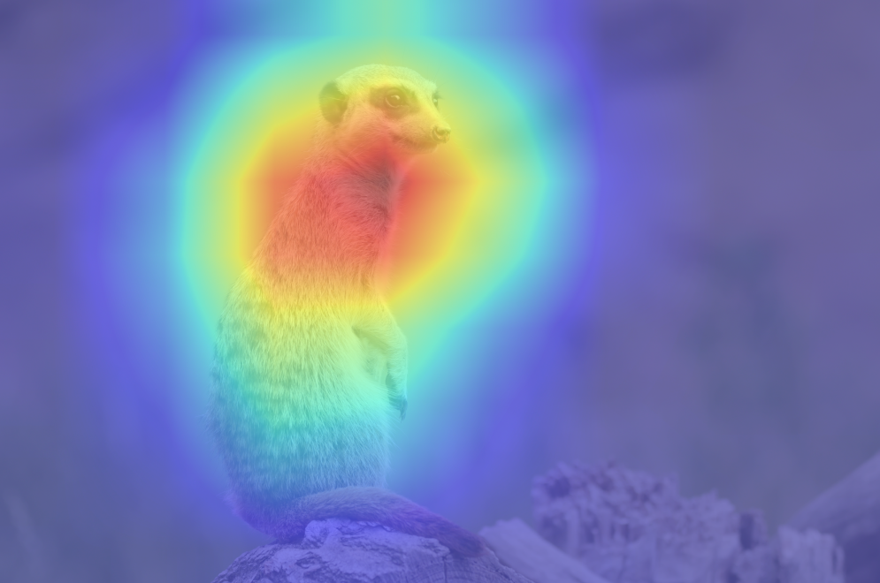
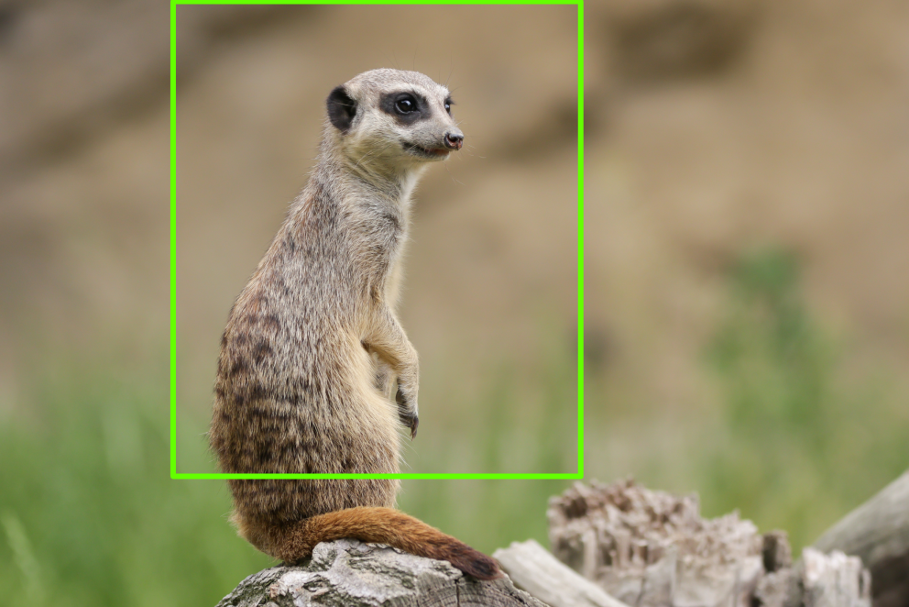
WSOL prior-art (deep learning)
Class Activation Mapping (CAM)
Baseline deep learning method of WSOL
Feature activations in higher layers used to localize objects
More related to object category
Loss of spatial accuracy due to lower resolution
Limitations
Focus on discriminative parts of object: Object partly localized
Parts in background may activate and be recognized as object
CAM research
Use other techniques to overcome limitations
E.g. region regularization (MinMaxCAM), gradient-weighted CAM (GradCAM), score-weighted CAM (ScoreCAM).
Large field of research

Slide 7
Problems of WSOL
Assumption of single object in image
No prior-art for multiple instance WSOL!
No evaluation protocol for multiple object instances
Interesting to evaluate multi-instance WSOL

Slide 8
Research question
Can weakly supervised object localization using CAM-methods to localize multiple instances of the same class?
This research
Define novel evaluation metrics for multi-instance WSOL
Benchmark multi-instance localization on specific CAM methods
Investigate improvements for multi-instance WSOL

Slide 9
Method
Multiple-instance WSOL

Slide 10
Localization based on CAM methods
CAM
Baseline method requires specific CNN with GAP layer and modified FC layer
Typically suffers drop in classification performance due to modified architecture
GradCAM
Generalization of CAM that doesn’t require modified CNN architecture.
ScoreCAM
More promising to capture features of multiple instances than GradCAM
MinMaxCAM
Better object coverage by regularization of the localization maps
Regularization requires re-training

Slide 11
Multiple-instance WSOL - Localization
VGG16
Tends to focus on discriminative features
Used in CAM, GradCAM, ScoreCAM, MinMaxCAM
Pre-trained VGG16 model on ImageNet-1k for GradCAM and ScoreCAM
VGG16-GAP variant required for CAM and MinMaxCAM
ResNet50
More recent than VGG16
Used in MinMaxCAM paper
Has GAP layer: Unmodified architecture for all CAM methods

Slide 12
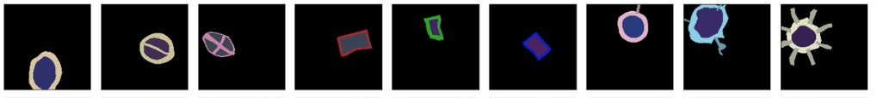


Multiple-instance WSOL – Datasets (Synthetic)
Synthetic dataset
Based on paper
“Quantifying Explainability of Saliency Methods in Deep Neural Network
9 classes
Single instance
Configurable parameters
Image size: 512x512
Instance count: 1..4
Disjunct or overlapping instances
Optional background
Ground truth labels
Segmentation masks for more accurate performance measurement
Bounding boxes for localization of multiple instances

Slide 13

Multiple-instance WSOL – Datasets (ImageNet-1k)
Used in all papers: CAM, Grad-CAM, ScoreCAM, MinMaxCAM
Ground-truth labels available for multi-instance WSOL
Single class label per image
Bounding boxes for all object instances in image (ILSVRC 2012)
Training set: 1.2M images
Propose to use subset of ImageNet-1k to limit computational requirements
Test set: 50k images
Use ImageNet-1k validation set as test set has no GT labels
Validation set: 10K images from ImageNetV2

Slide 14
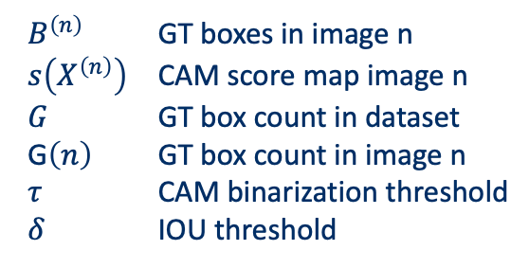
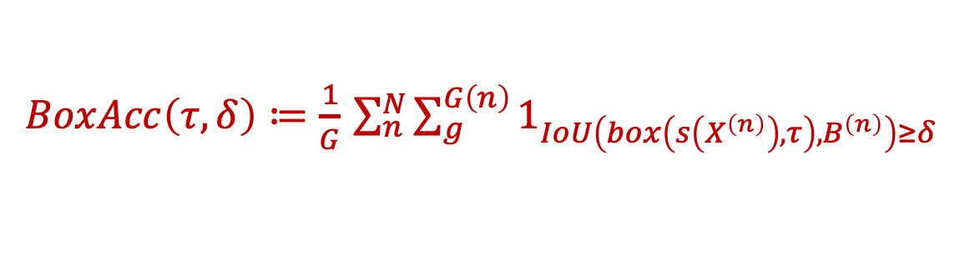
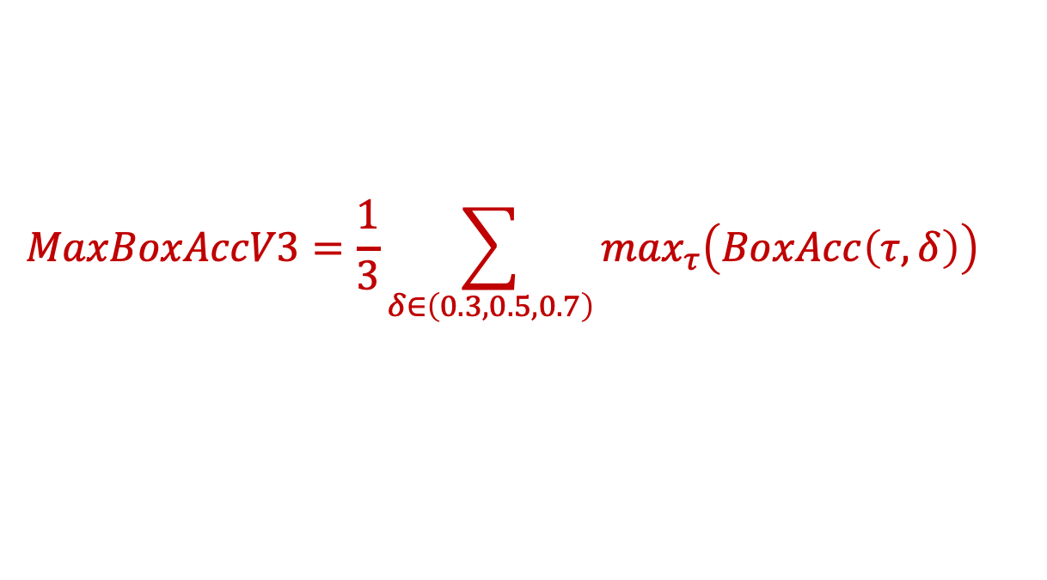
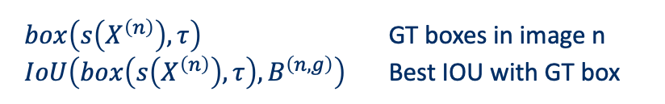
Metrics – MaxBoxAccV3
$$MaxBoxAccV3=\frac{1}{3}\sum_{δ∈\left(0.3,0.5,0.7\right)}{\max_{τ}\left(BoxAcc\left(τ,δ\right)\right)}$$
Threshold-independent
$BoxAcc\left(τ,δ\right)≔\frac{1}{G}$ $\sum_{n}^{N}{\sum_{g}^{G\left(n\right)}{1_{IoU\left(box\left(s\left(X^{\left(n\right)}\right),τ\right),B^{\left(n\right)}\right)≥δ}}}$
$B^{\left(n\right)}$ GT boxes in image n
$s\left(X^{\left(n\right)}\right)$ CAM score map image n
$G$ GT box count in dataset
G$\left(n\right)$ GT box count in image n
$τ$ CAM binarization threshold
$δ$ IOU threshold
$box\left(s\left(X^{\left(n\right)}\right),τ\right)$ GT boxes in image n
$IoU\left(box\left(s\left(X^{\left(n\right)}\right),τ\right),B^{\left(n,g\right)}\right)$ Best IOU with GT box

Slide 15
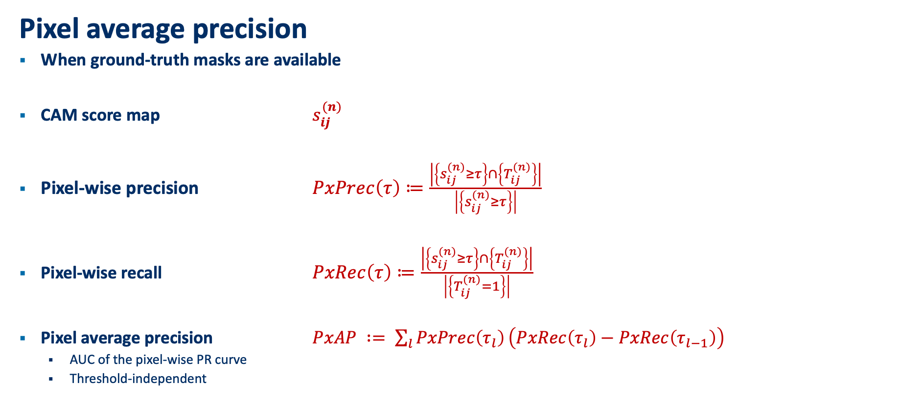
Multiple-instance WSOL - Metrics
Pixel average precision
When ground-truth masks are available
CAM score map $s_{ij}^{(n)}$
Pixel-wise precision $PxPrec\left(τ\right)≔\frac{\left|\left\{s_{ij}^{(n)}≥τ\right\}\right.∩\left.\left\{T_{ij}^{(n)}\right\}\right|}{\left|\left\{s_{ij}^{(n)}≥τ\right\}\right|}$
Pixel-wise recall $PxRec\left(τ\right)≔\frac{\left|\left\{s_{ij}^{(n)}≥τ\right\}\right.∩\left.\left\{T_{ij}^{(n)}\right\}\right|}{\left|\left\{T_{ij}^{(n)}=1\right\}\right|}$
Pixel average precision $PxAP ∶= \sum_{l}{PxPrec\left(τ_{l}\right)}\left(PxRec\left(τ_{l}\right)−PxRec\left(τ_{l−1}\right)\right)$
AUC of the pixel-wise PR curve
Threshold-independent

Slide 16
Multiple-instance WSOL - Improvements
Challenge
1 operational threshold to extract bounding boxes
Not all object instances of similar intensity
Proposal: Iterative bounding box extraction
Process
Bounding boxes with most intensity are extracted first with operational CAM threshold
Bounding boxes are masked (deleted, greyed, noise-filled) in CAM score map
Operational CAM threshold is lowered. Repeat 1.
Possible stop criterion:
No bounding boxes are found
Minimum CAM threshold reached.
Prediction score drop threshold reached when modified CAM score map fed to network.

Slide 17
Experiments

Slide 18
Localization performance – SYNTHETIC dataset
 | MaxBoxAccV3
 | VGG16-GAP |  |  |  | VGG16
Method | 1 | 2 | 3 | 4 | 1 | 2 | 3 | 4
CAM | 86.83 | 45.58 | 41.50 | 15.78 | - | - | - | -
GradCAM | 86.83 | 45.58 | 41.50 | 15.78 | 74.50 | 32.08 | 30.17 | 9.17
ScoreCAM | 91.83 | 60.08 | 56.28 | 26.49 | 70.50 | 43.08 | 35.17 | 13.25
MinMaxCAM | 87.17 | 48.91 | 45.99 | 16.75 | - | - | - | -

Slide 19
Localization performance – SYNTHETIC dataset
 | PxAP
 | VGG16-GAP |  |  |  | VGG16
Method | 1 | 2 | 3 | 4 | 1 | 2 | 3 | 4
CAM | 87.77 | 64.49 | 59.16 | 29.69 | - | - | - | -
GradCAM | 87.77 | 64.49 | 59.16 | 29.69 | 68.36 | 39.59 | 42.24 | 13.12
ScoreCAM | 86.77 | 71.14 | 68.43 | 39.58 | 69.24 | 53.80 | 46.13 | 21.56
MinMaxCAM | 87.56 | 66.37 | 61.97 | 31.29 | - | - | - | -

Slide 20
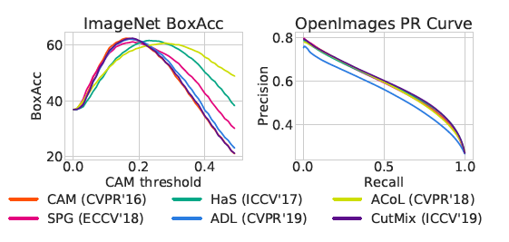
Localization performance at varying CAM thresholds
Example from Choe et al., 2020b

Slide 21
Learning curves
Best localization performance
Achieved at earlier epochs than best classification performance
Classification training hurts localization performance
In line with Choe et al, 2020b
<plot: classification/localization per epoch for val set >

Slide 22
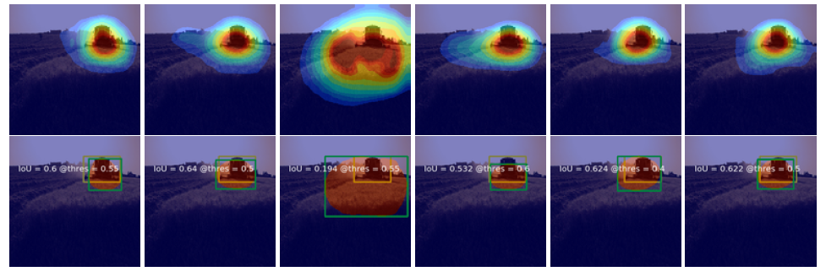
Qualitative analysis
<side-by-side xai image of each CAM method>
Discuss differences for 1 instance and multiple instances
Example from Choe, et al. 2020b

Slide 23
Next steps

Slide 24
Next steps
CAM method benchmarking for ImageNet-1k dataset
Localization improvements using iterative bounding box extraction
Conclusions

Slide 25



Slide 26
Backup

Slide 27
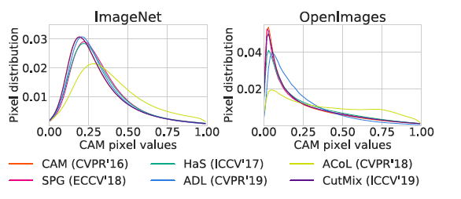
CAM pixel value distributions
Example from Choe et al., 2020b
CAM pixel value distributions (E.g. figure 13 in WSOL evaluation paper)

Slide 28
Cumulative distribution function (CDF)
To be investigated if useful
CDF of what?
Pixel values? (same as pixel distribution slide)

